Slide 1
Analyzing vehicle sales among brands to SQL query
Present by: lohit & pavithra.

Slide 2
Introduction
Analyzing vehicle sales among brands is essential for understanding market trends, customer preferences, and overall brand performance. By using SQL queries, we can efficiently extract and analyze data from a database to gain insights into vehicle sales patterns. This process involves writing queries to retrieve data such as total sales, sales distribution across different brands, sales growth over time, and more. The results of these analyses can help businesses make informed decisions, optimize their strategies, and improve their competitive edge in the market.

Slide 3
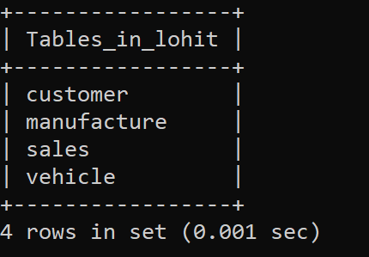
tables
show tables;

Slide 4
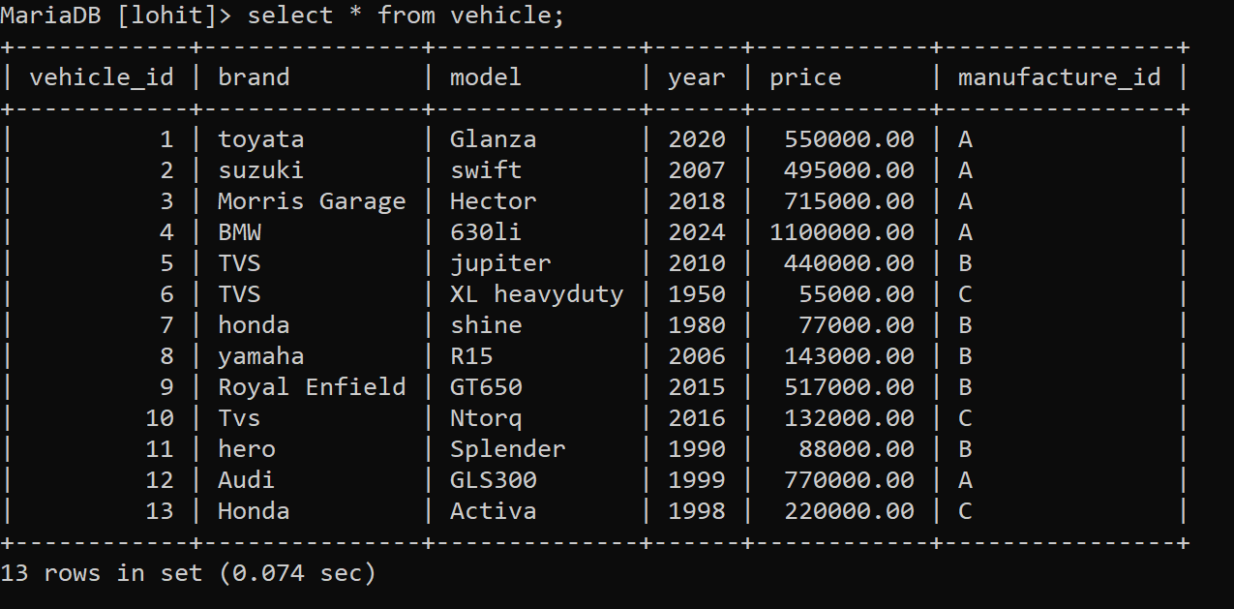
Table vehicle

Slide 5
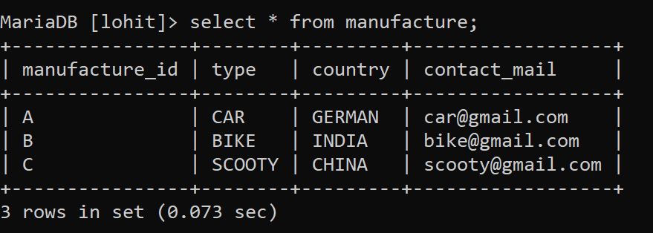
table manufacture

Slide 6
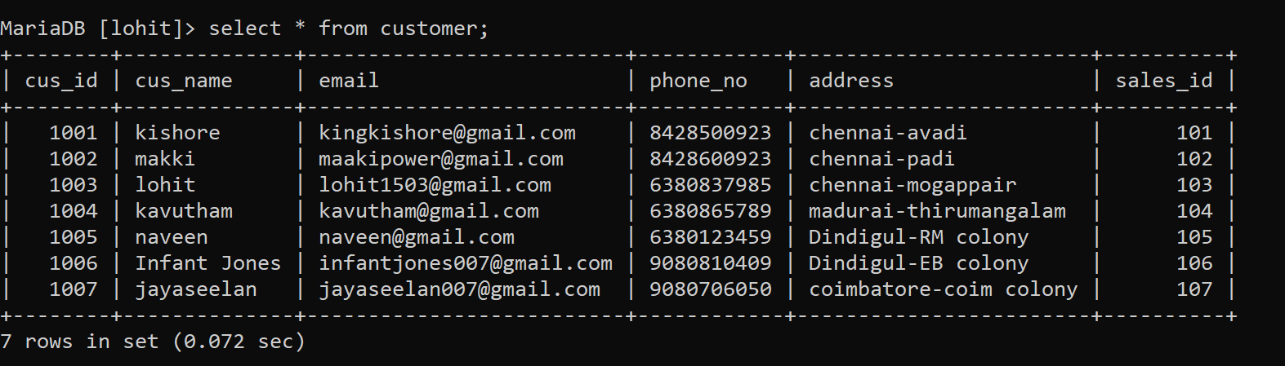
table customer

Slide 7
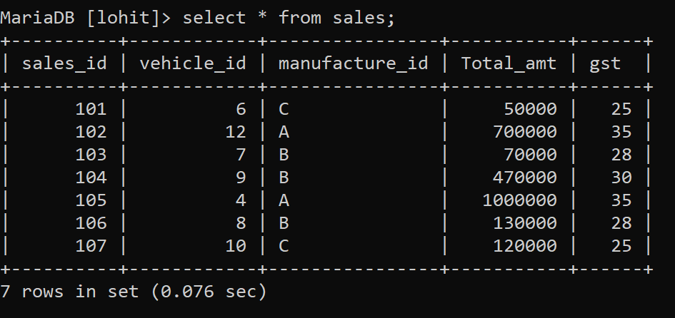
table sales

Slide 8
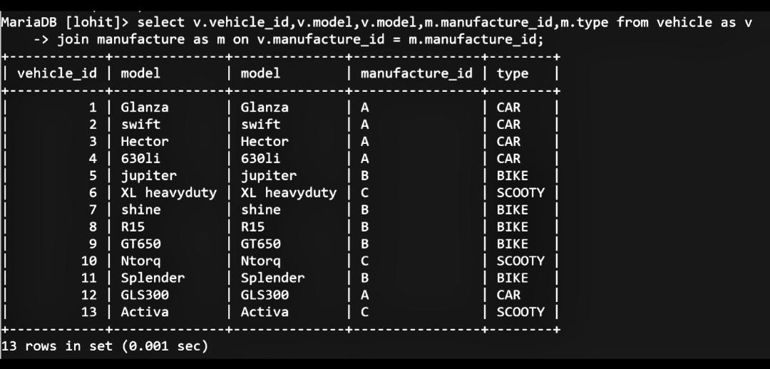
1. List the all vehicles along with the manufacture details:

Slide 9
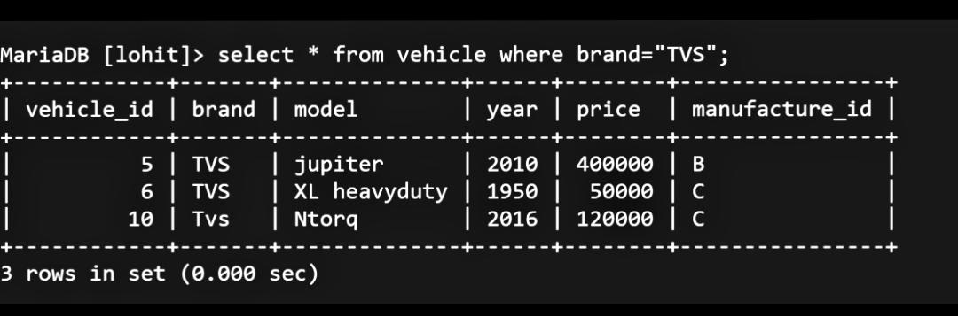
2.Retrieve the vehicles manufactured by TVS:

Slide 10
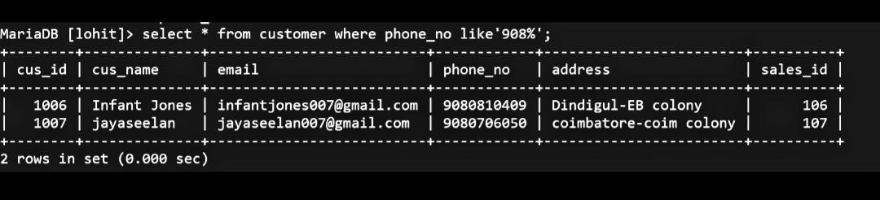
3. Customers with the phone number starting with ‘908’:

Slide 11
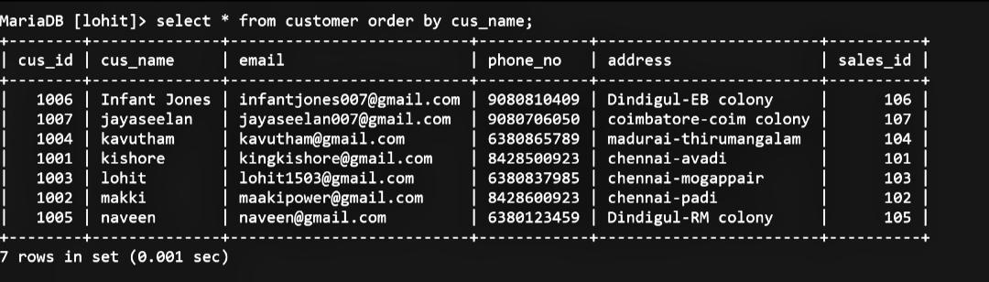
4.List of all customers sort by their names:

Slide 12
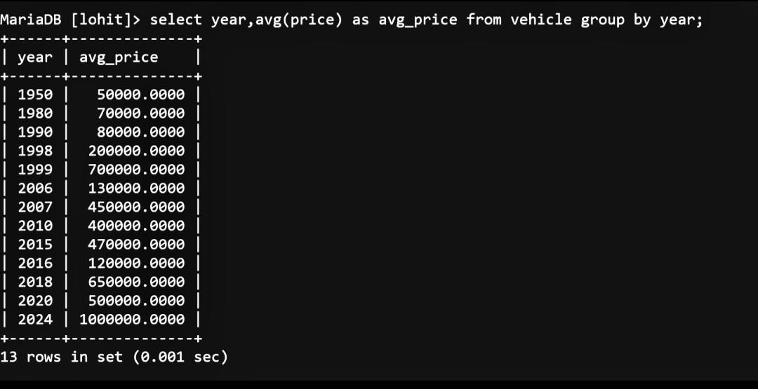
5.Average price of vehicle by the year:

Slide 13
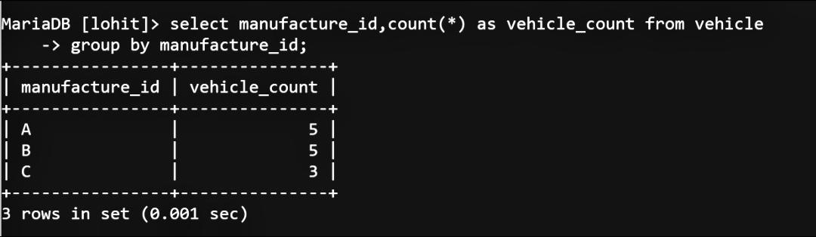
6.Number of vehicles manufactured by each manufacture:

Slide 14
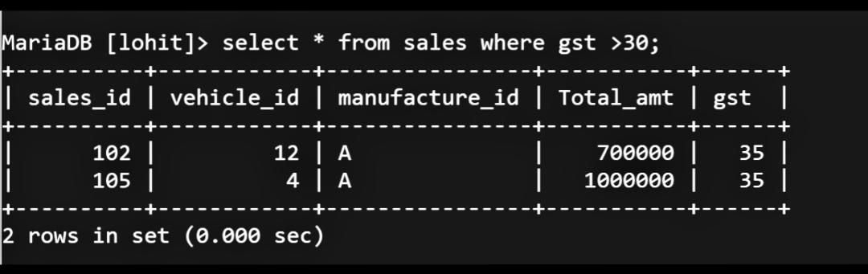
7.All sales with the GST rate are higher than 30:

Slide 15
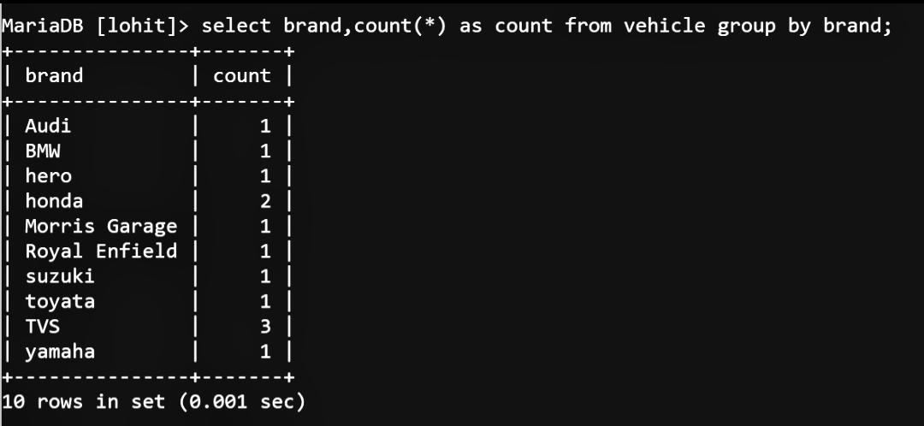
8.Count the vehicles by brand:

Slide 16
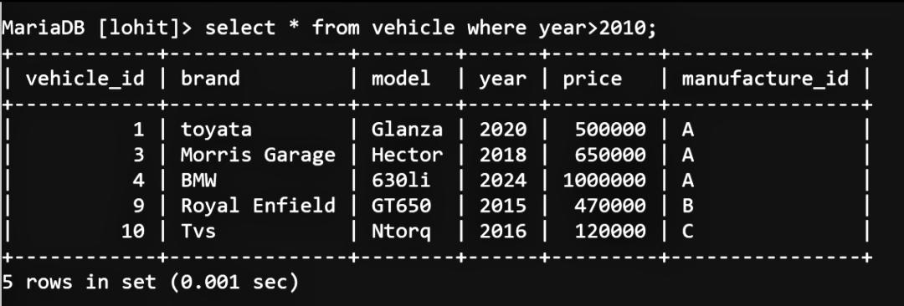
9.List all vehicles manufactured before the year 2010:

Slide 17
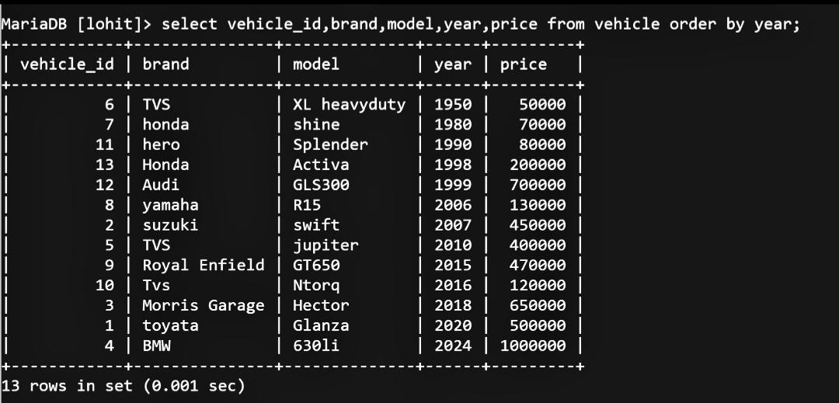
10.Vehicle and the price sort by the year:

Slide 18
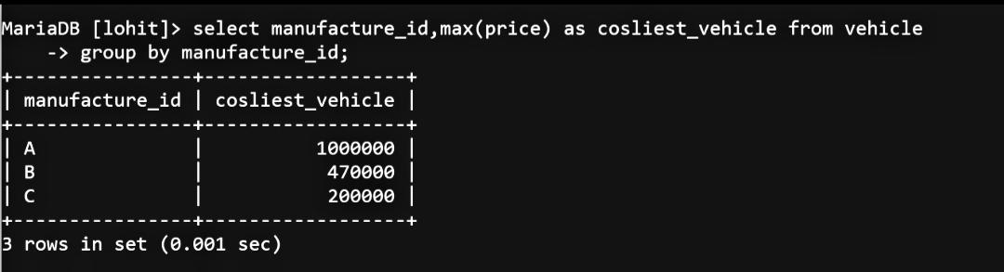
11.The costliest priced vehicle each by the manufacturer:

Slide 19
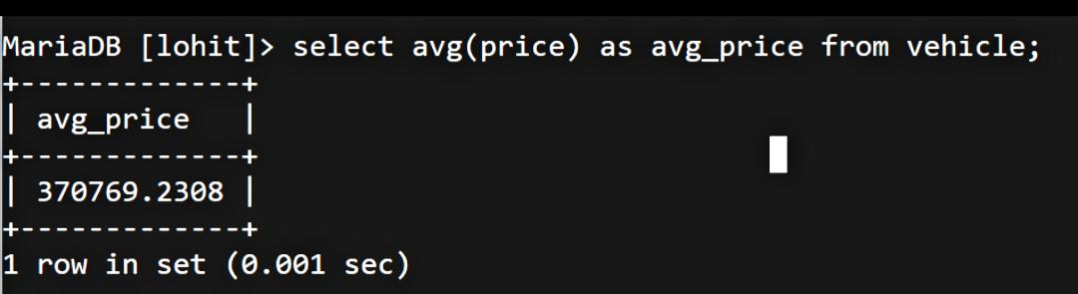
12.average price of vehicle by the year:

Slide 20
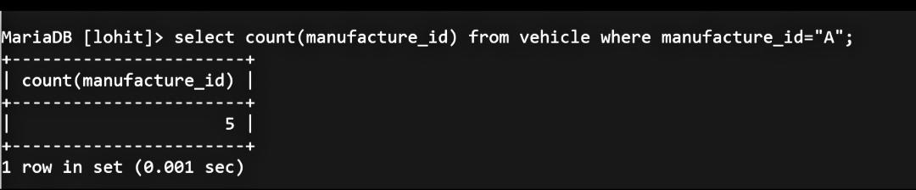
13.Finding the total vehicle manufactured in type=“A”.

Slide 21
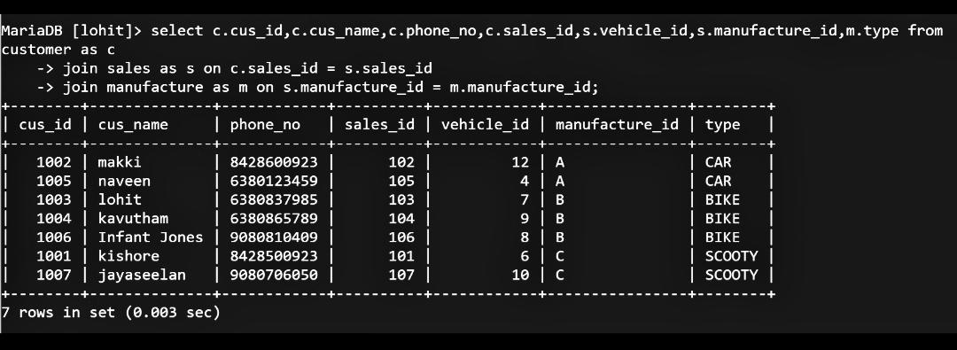
14.Find Customers and vehicles they bought:

Slide 22
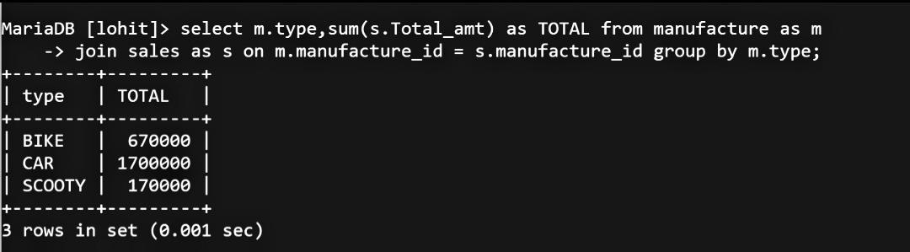
15.Total sales amount for each type of manufactured vehicles:

Slide 23
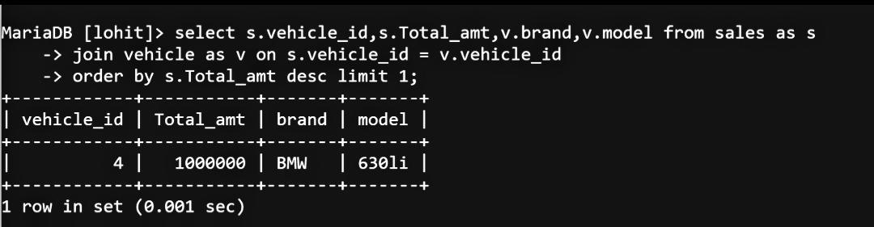
16.Find the most expensive vehicles sold :

Slide 24
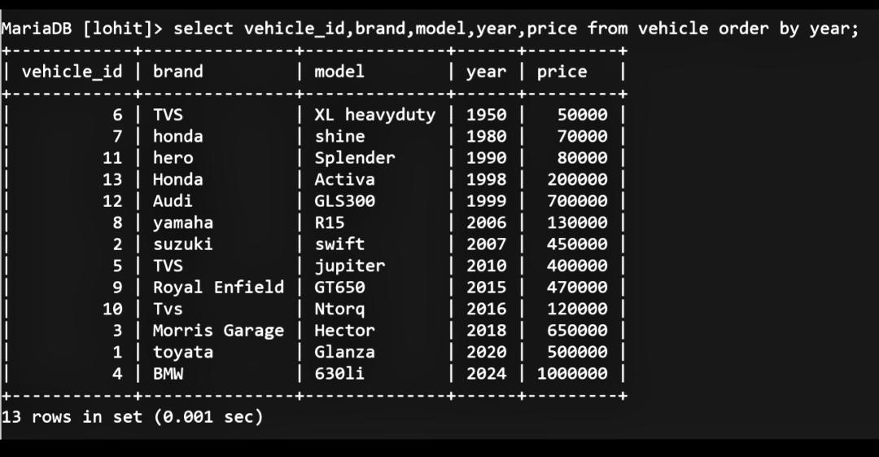
17.Vehicles and brand sort by year :

Slide 25
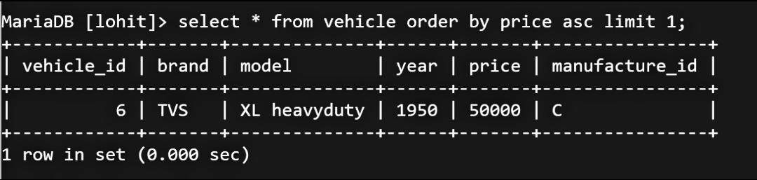
18.Find the vehicle sold for lowest price :

Slide 26
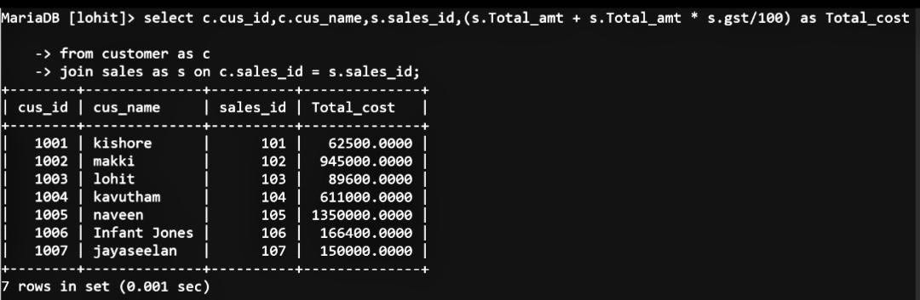
19.find the total price for the customer with adding the gst with total price:

Slide 27
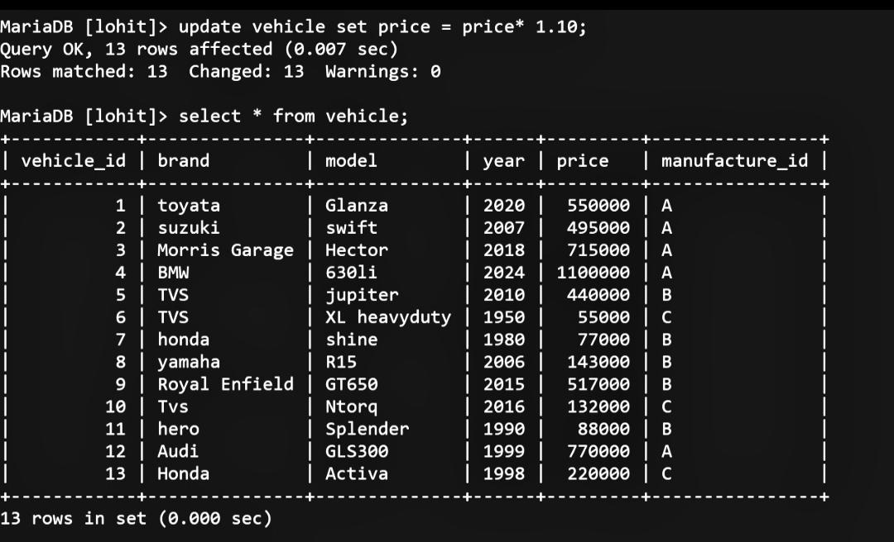
20.Update the price of all vehicles by increasing it by 10%:

Slide 28
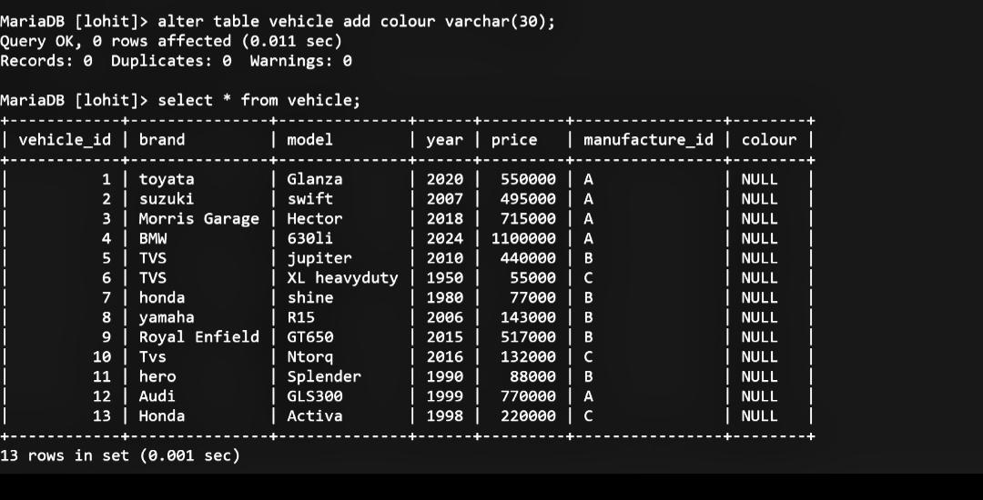
21.add a column color to the vehicle table:

Slide 29
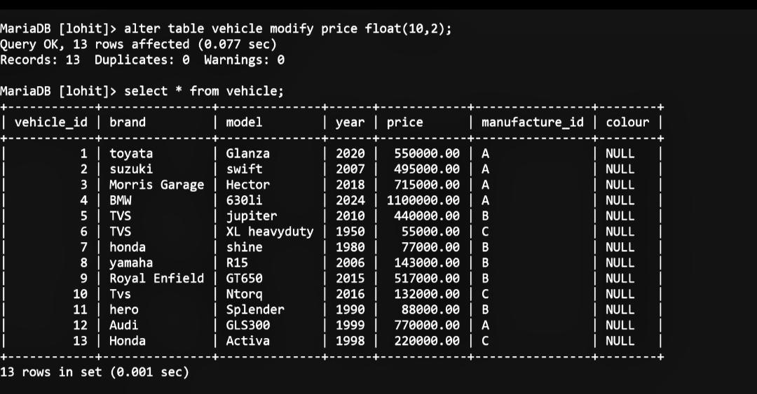
22.Modify the price column in the vehicle table to DECIMAL(10, 2):

Slide 30
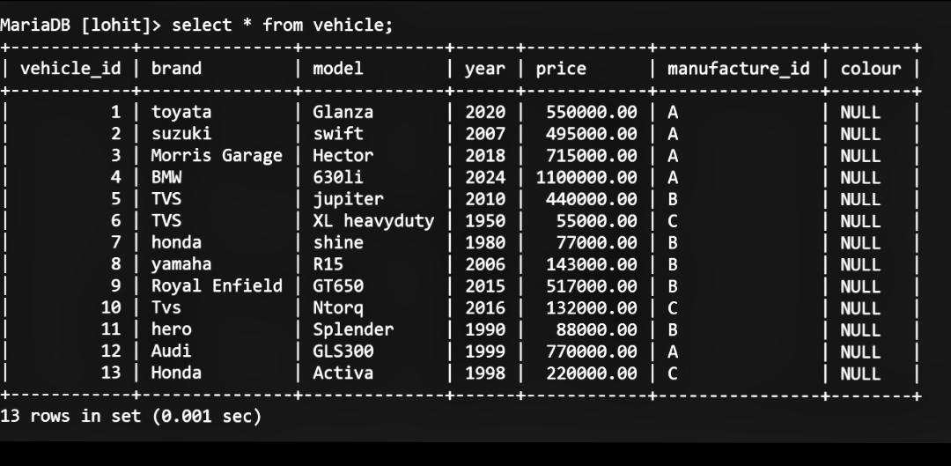
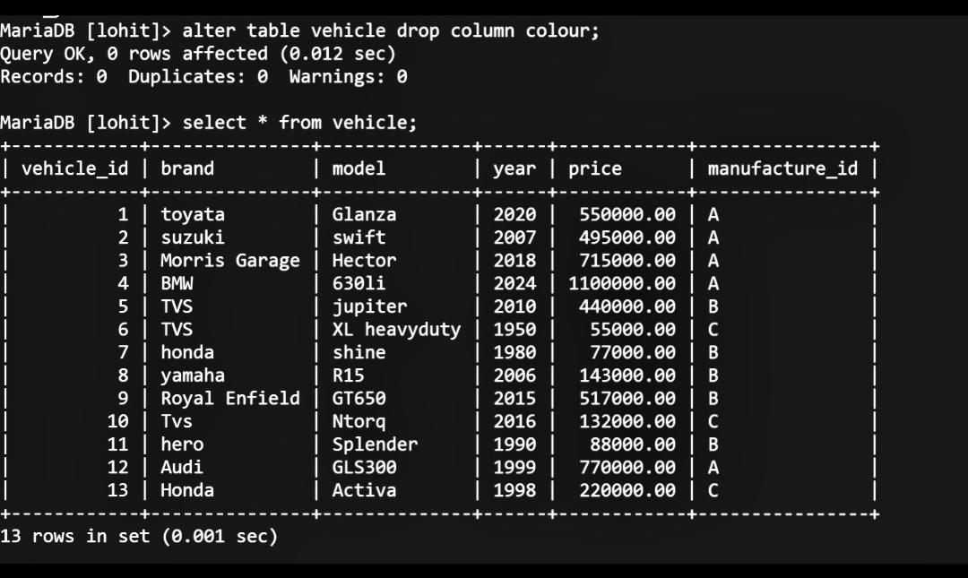
23.Sql query to drop column ‘colour’ :

Slide 31

Present by: pavithra & lohith

